Slide 1
Laplace Transform
IT3105: Signals & Systems

Slide 2

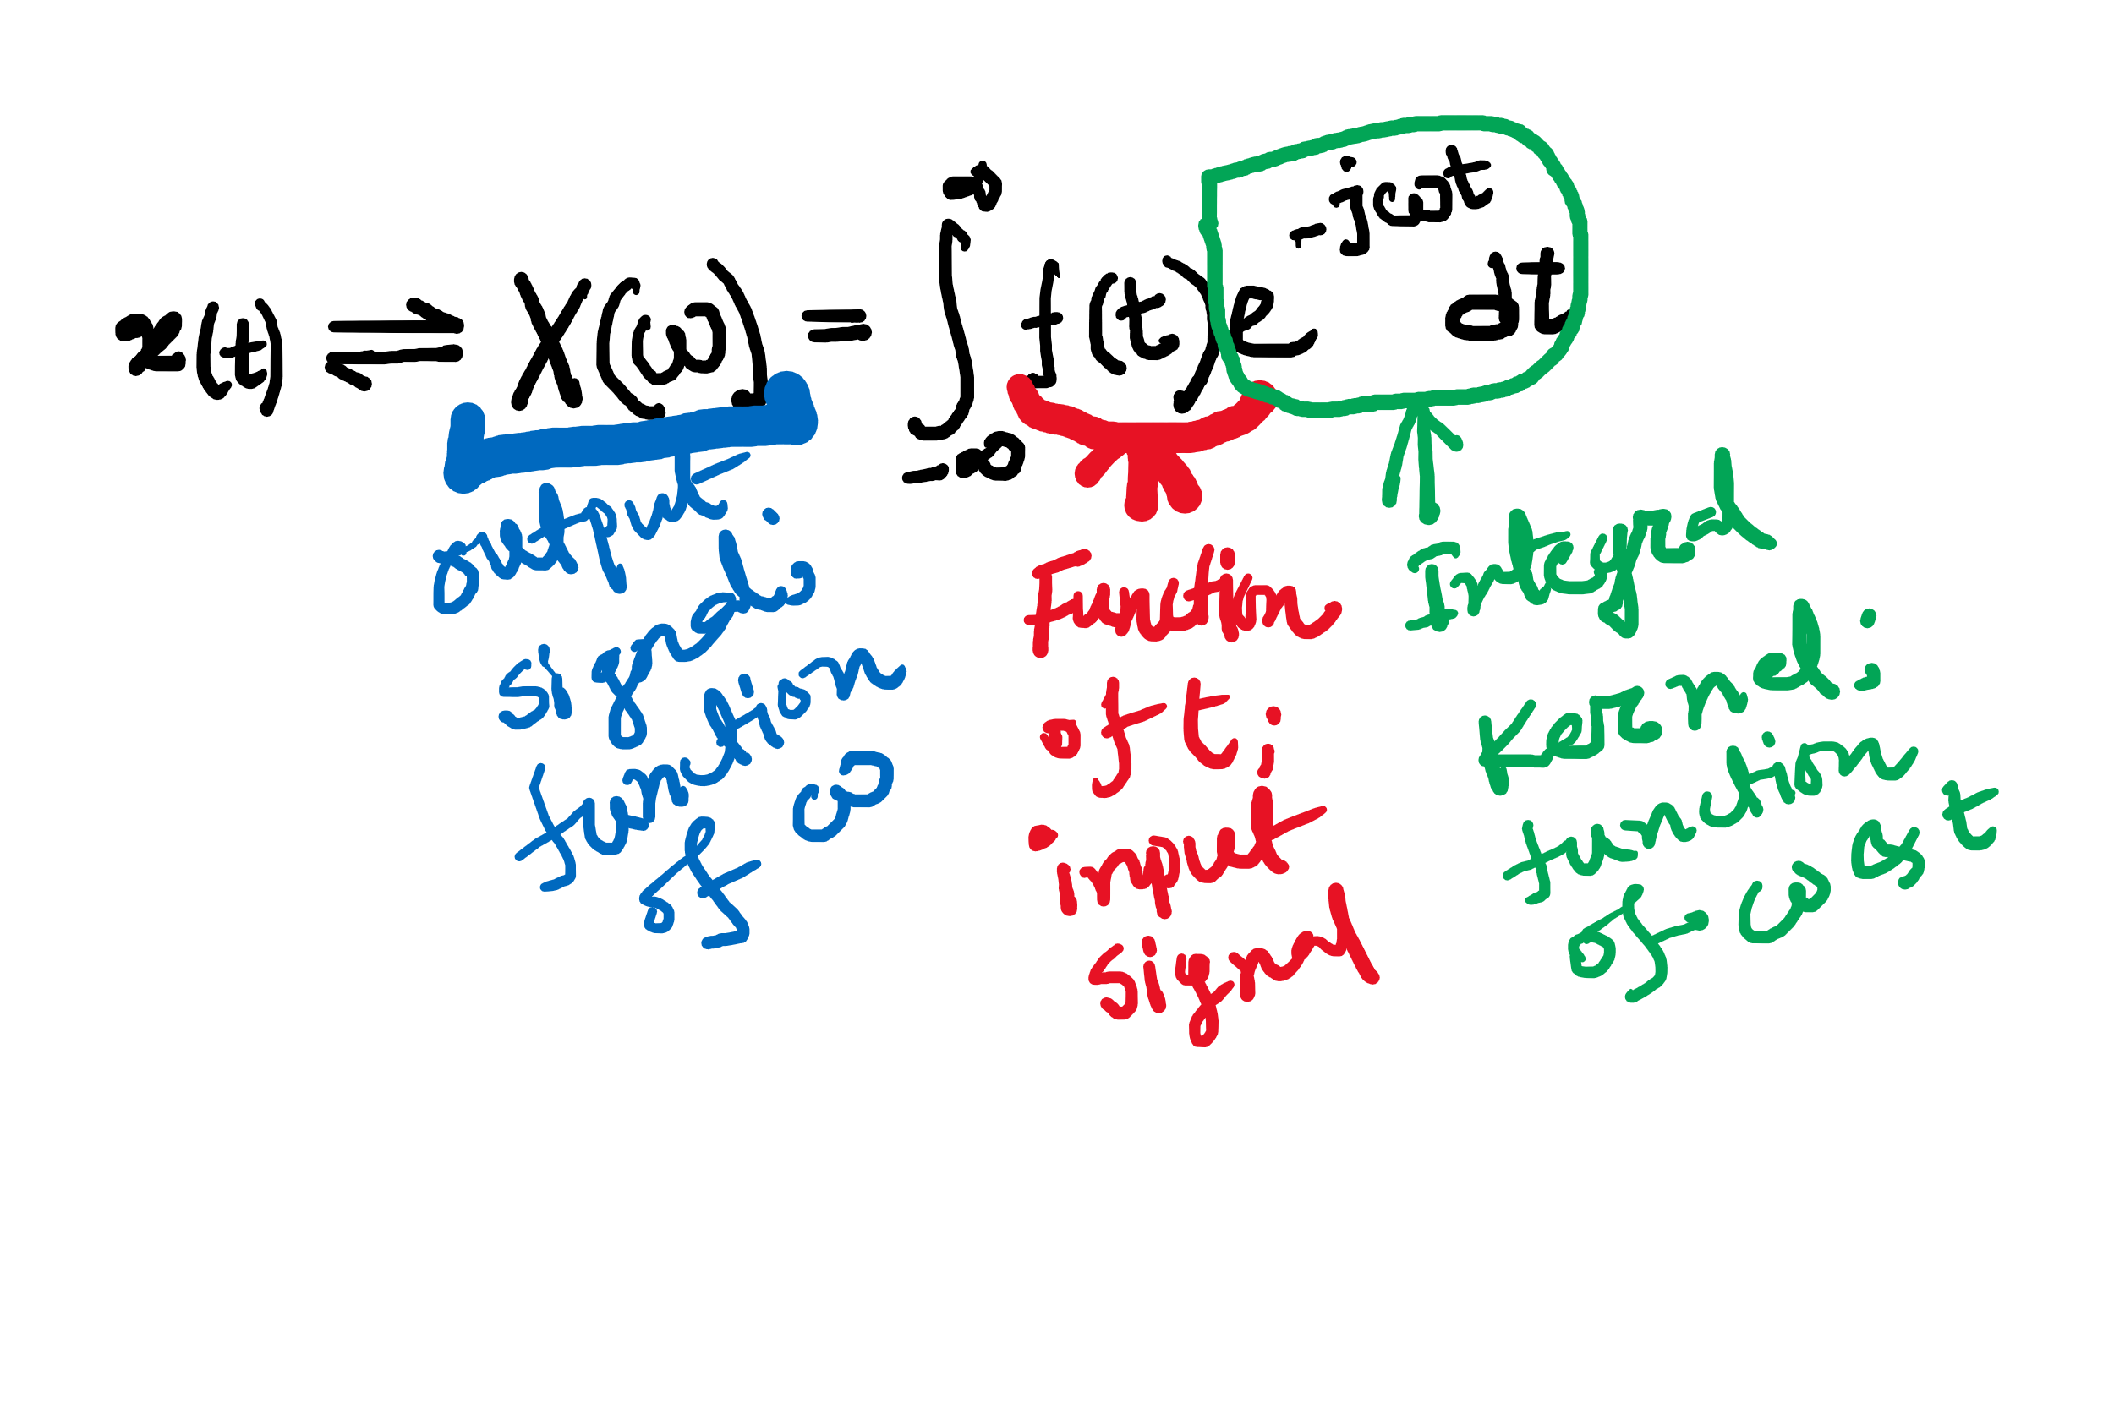
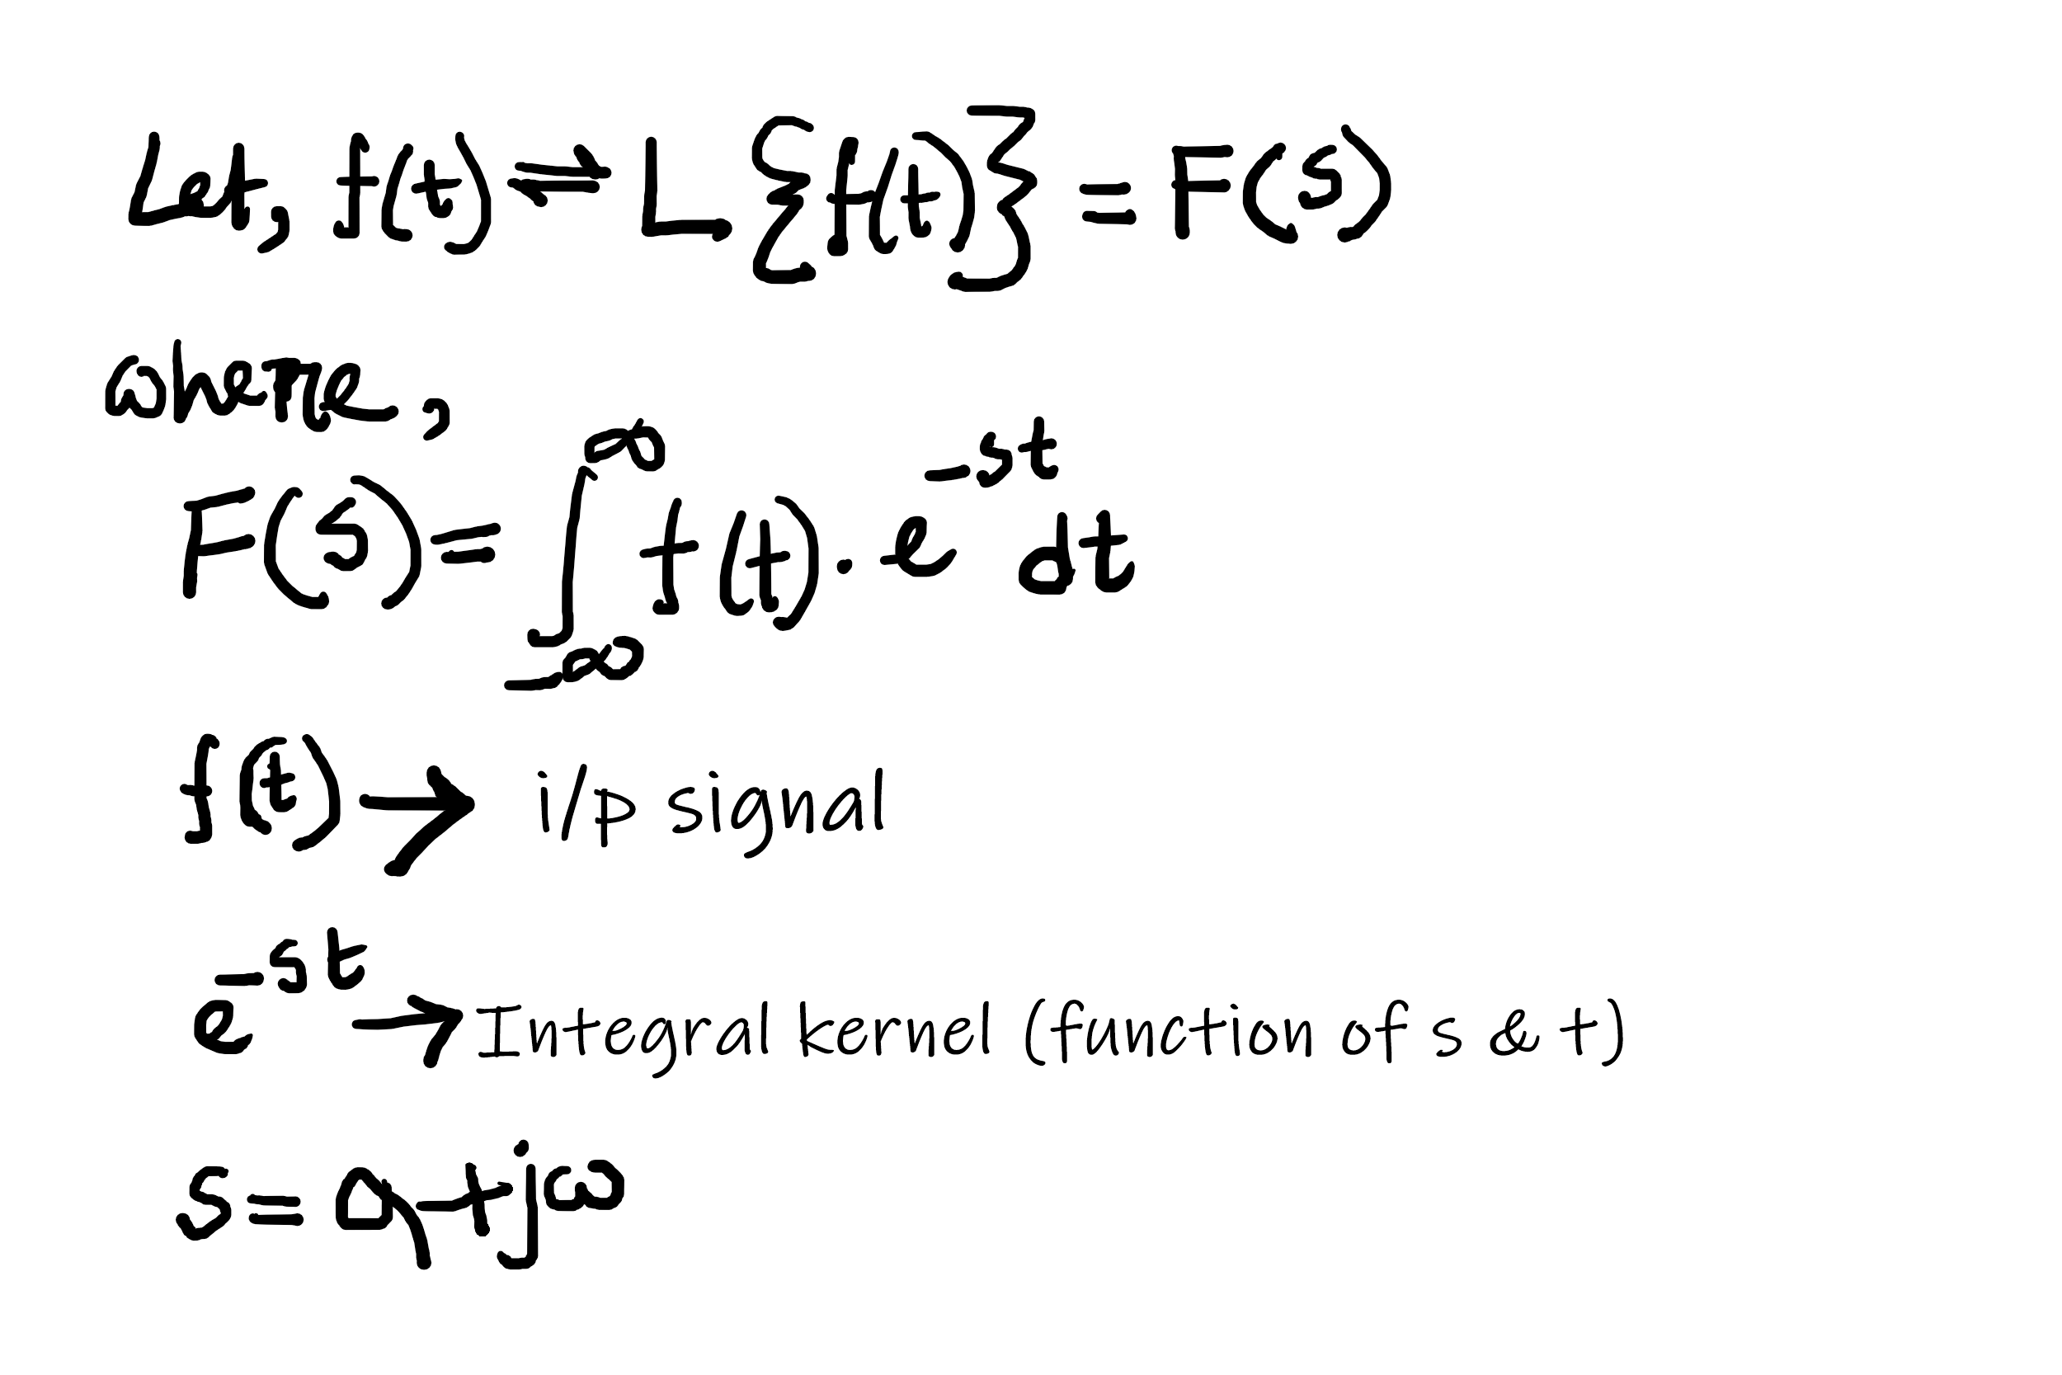
Introduction to LT
Proposed by French mathematician and astronomer, Pirre-Simon Laplace.
Laplace transform is used for designing purpose.
Laplace transform is the general form of Fourier transform. FT is integral function.
So Laplace transform is the general
form of Fourier Transform.

Slide 3
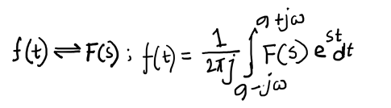
Introduction to LT
In FT, we have “ω”, which is a real variable, which is replacing with “s”, which is a complex variable, by using a complex variable we are generalizing FT.
S = σ+jω; where σ = damping factor and ω = frequency (rad/sec)
There are two forms of LT such as:
Bilateral LT, which integration from ‒∞ to ∞.
Unilateral/ one sided LT where t ≥ 0 i.e. integration from 0 to ∞.
For Bilateral LT, we need to calculate region of convergence (ROC), is the region in the ‘s’ plane. We can get ‘s’ plane by considering all possible values of σ and ω. In ‘s’ plane, ROC is where LT is finite and outside ROC, LT is infinite.
Inverse LT,
To solve any problem we can not use the integral form, we use partial fraction.

Slide 4
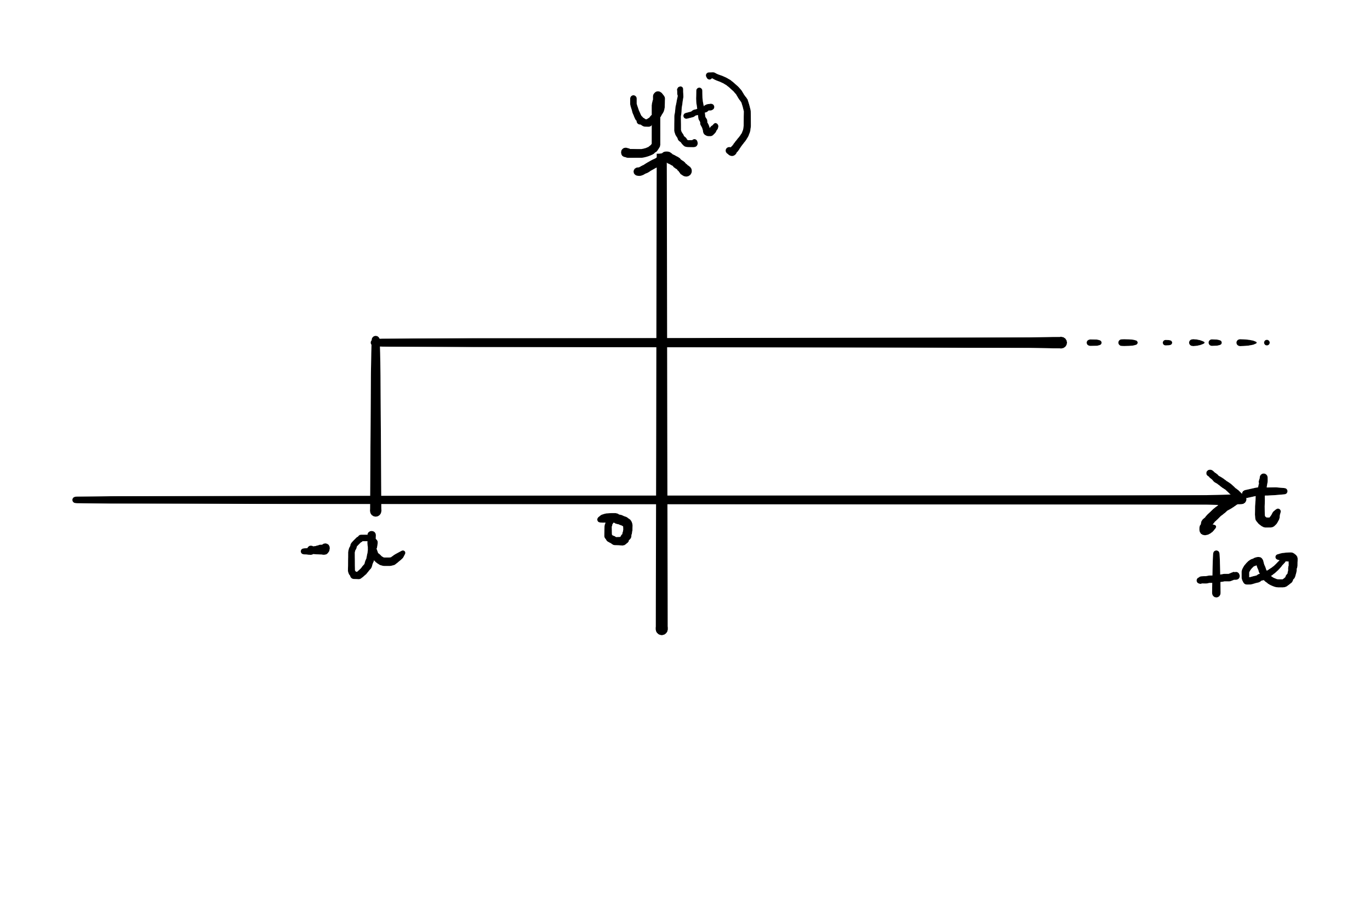
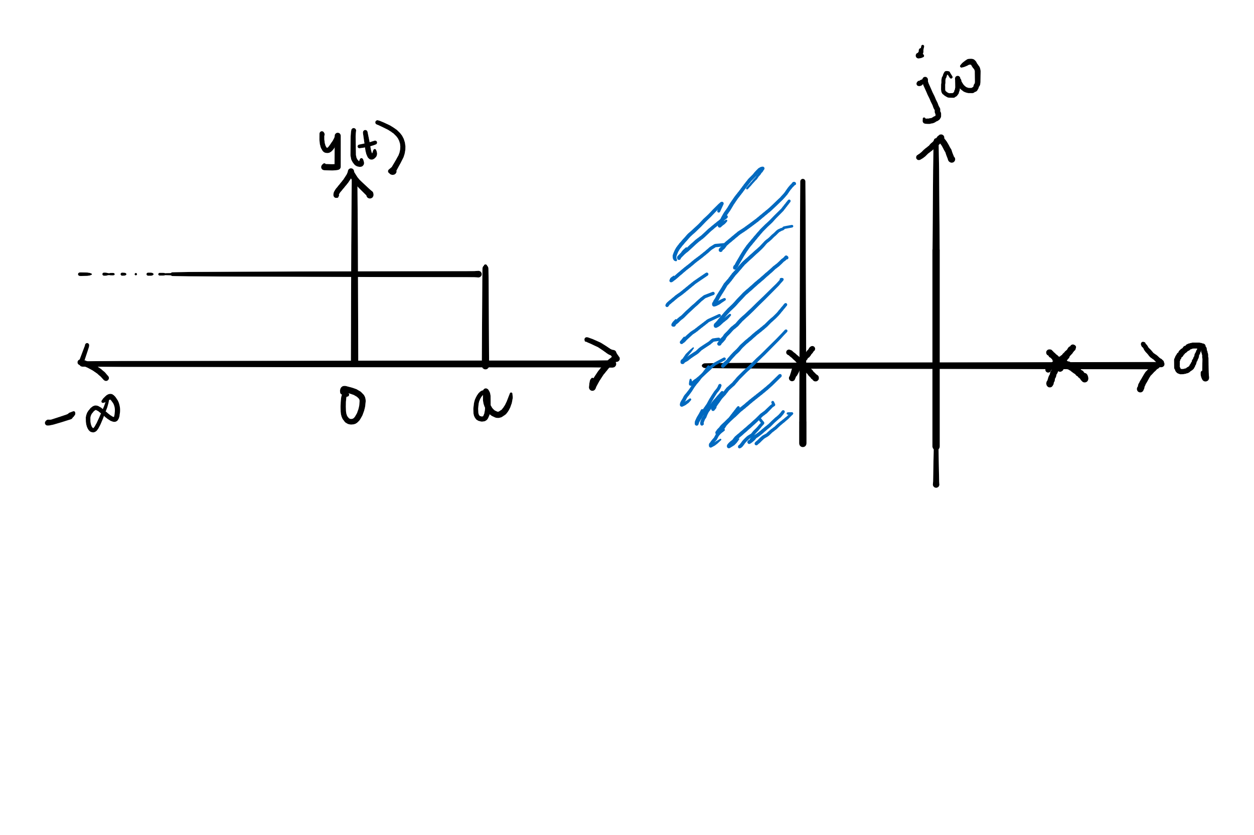
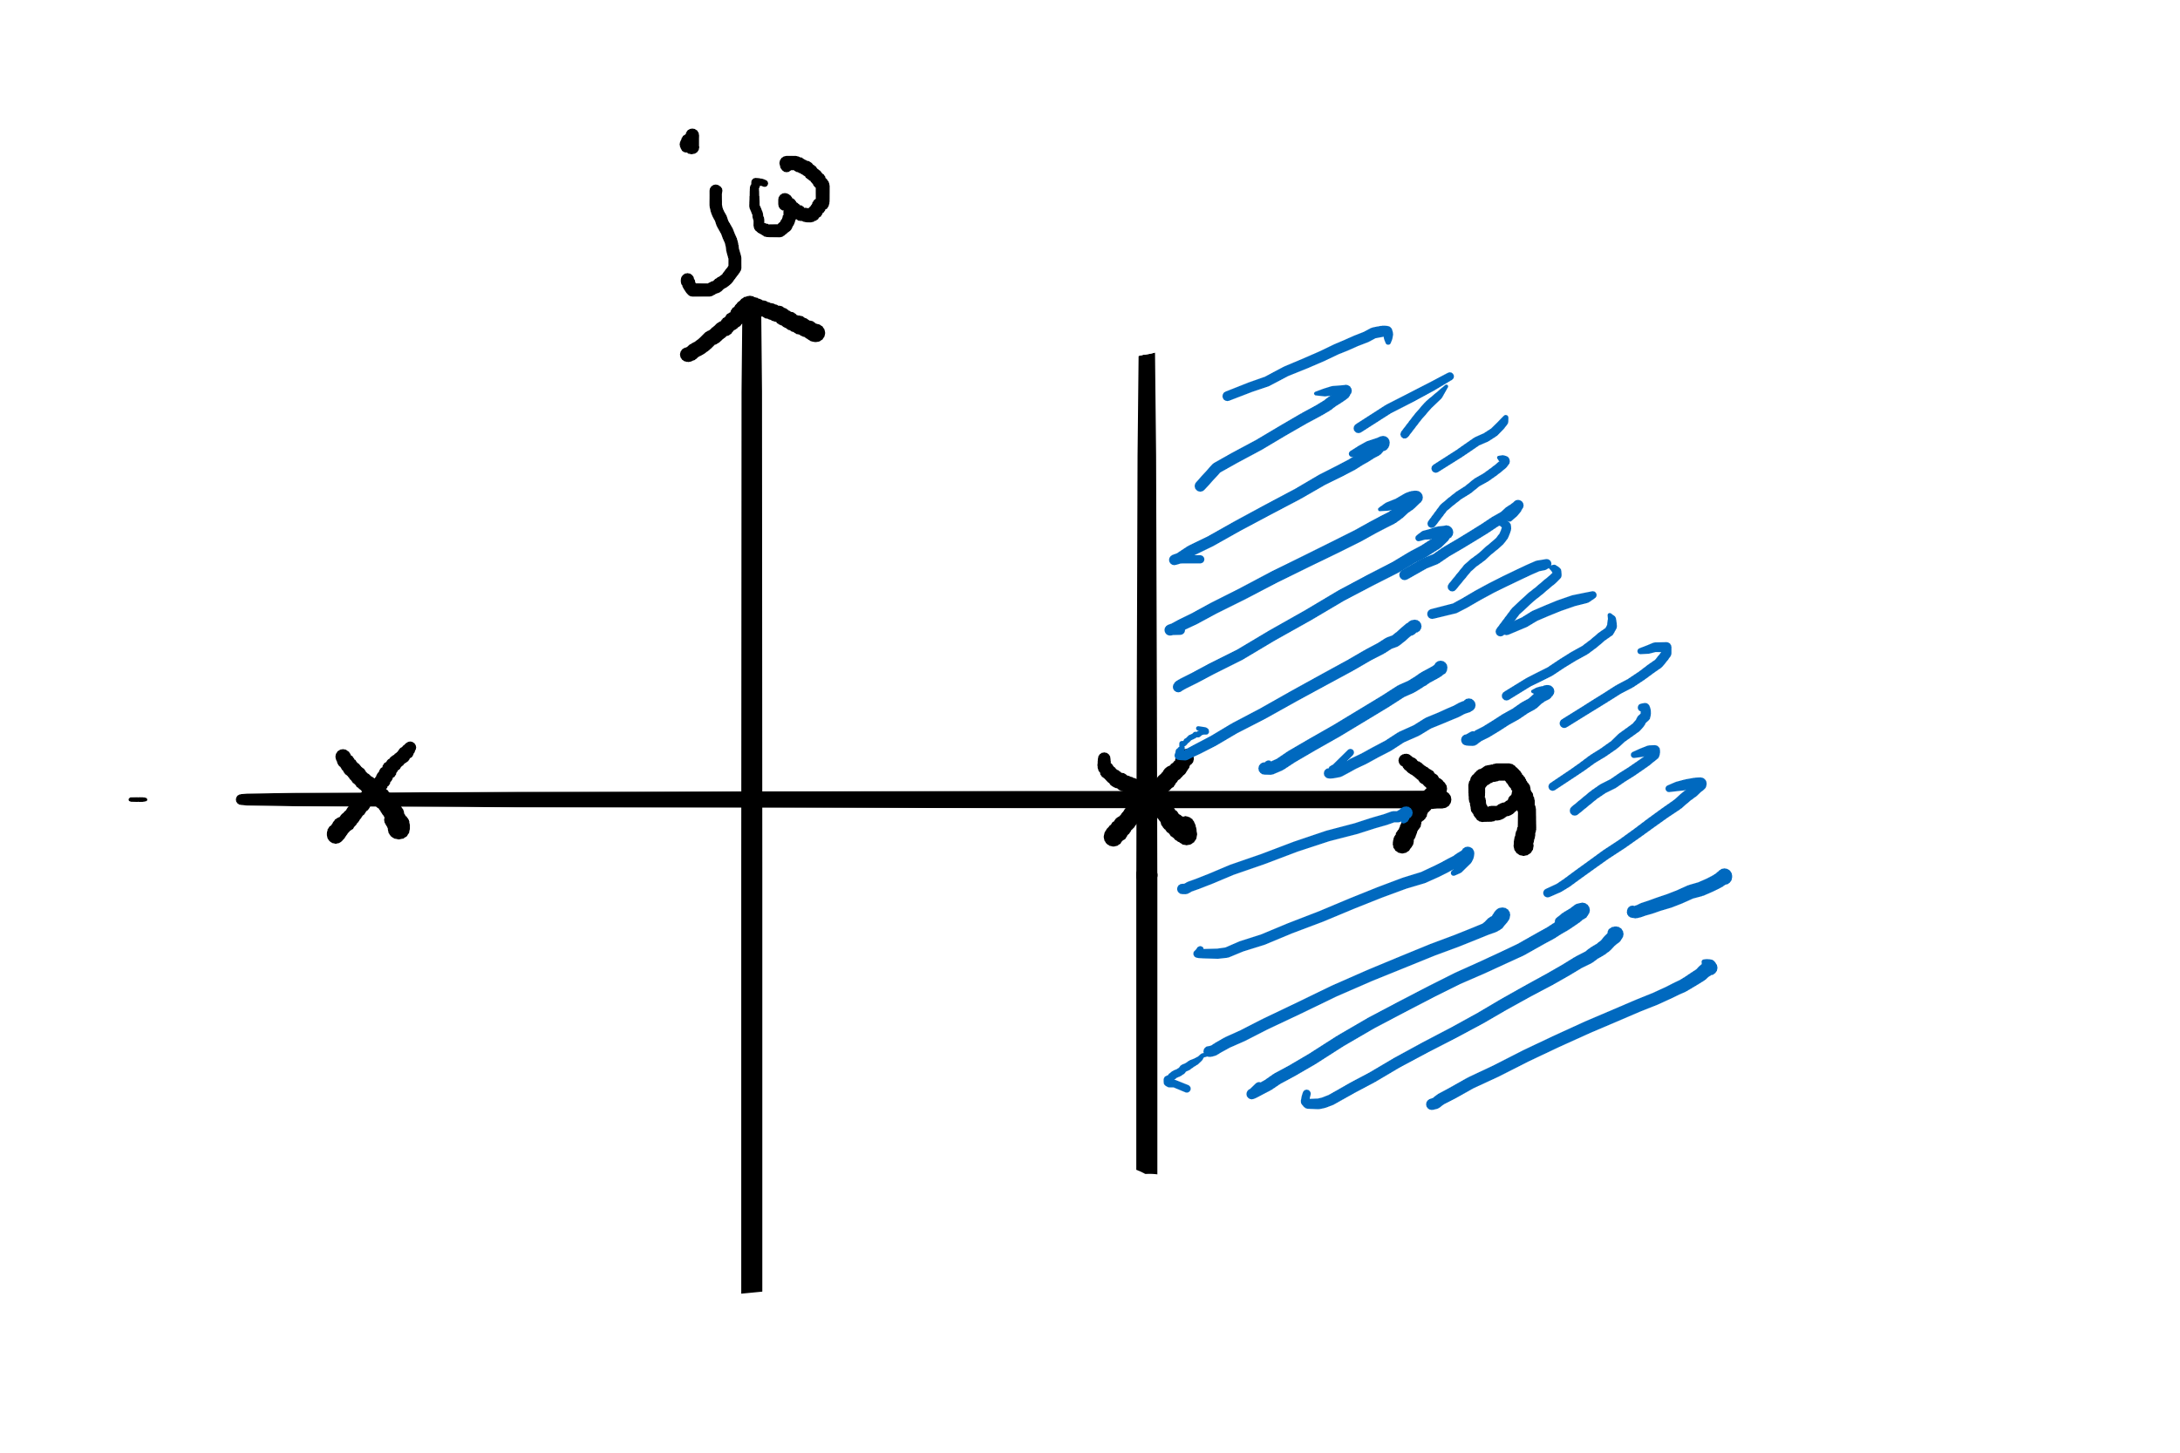
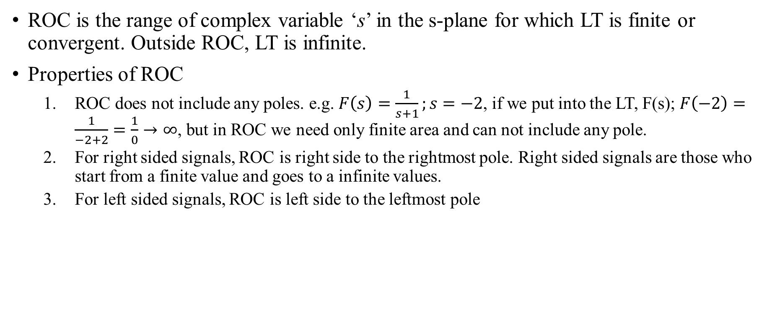
ROC & Its Properties
ROC is the range of complex variable ‘s’ in the s-plane for which LT is finite or convergent. Outside ROC, LT is infinite.
Properties of ROC
ROC does not include any poles. e.g. $F\left(s\right)=\frac{1}{s+1};s=−2$, if we put into the LT, F(s); $F\left(−2\right)=\frac{1}{−2+2}=\frac{1}{0}→∞$, but in ROC we need only finite area and can not include any pole.
For right sided signals, ROC is right side to the rightmost pole. Right sided signals are those who start from a finite value and goes to a infinite values.
For left sided signals, ROC is left side to the leftmost pole

Slide 5
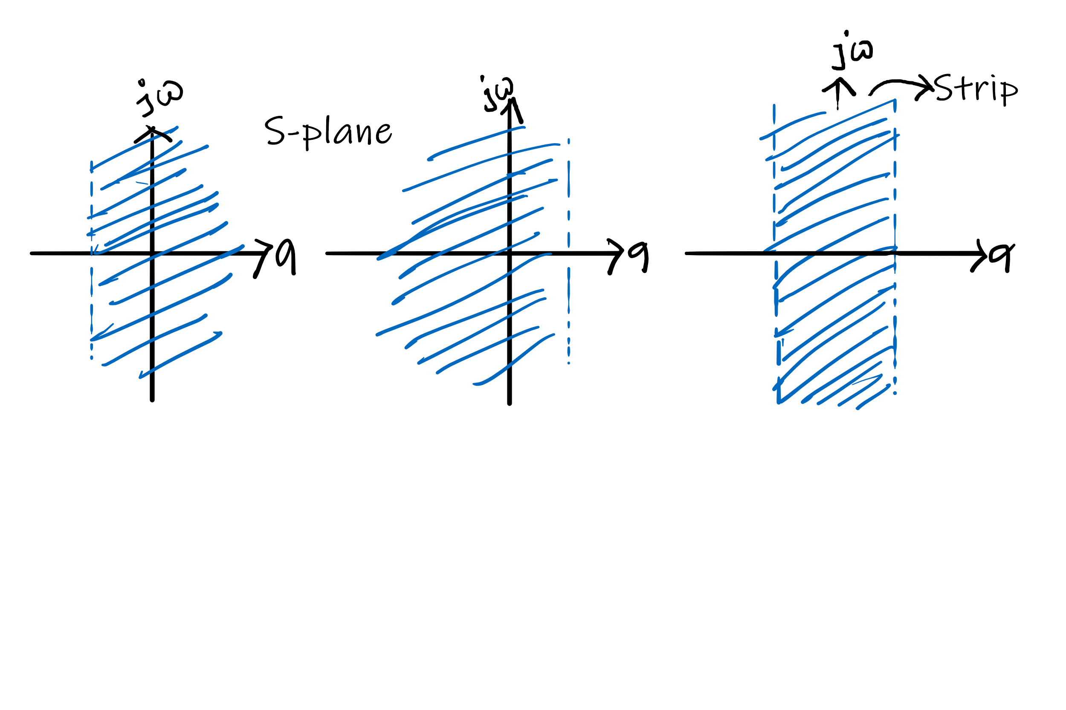
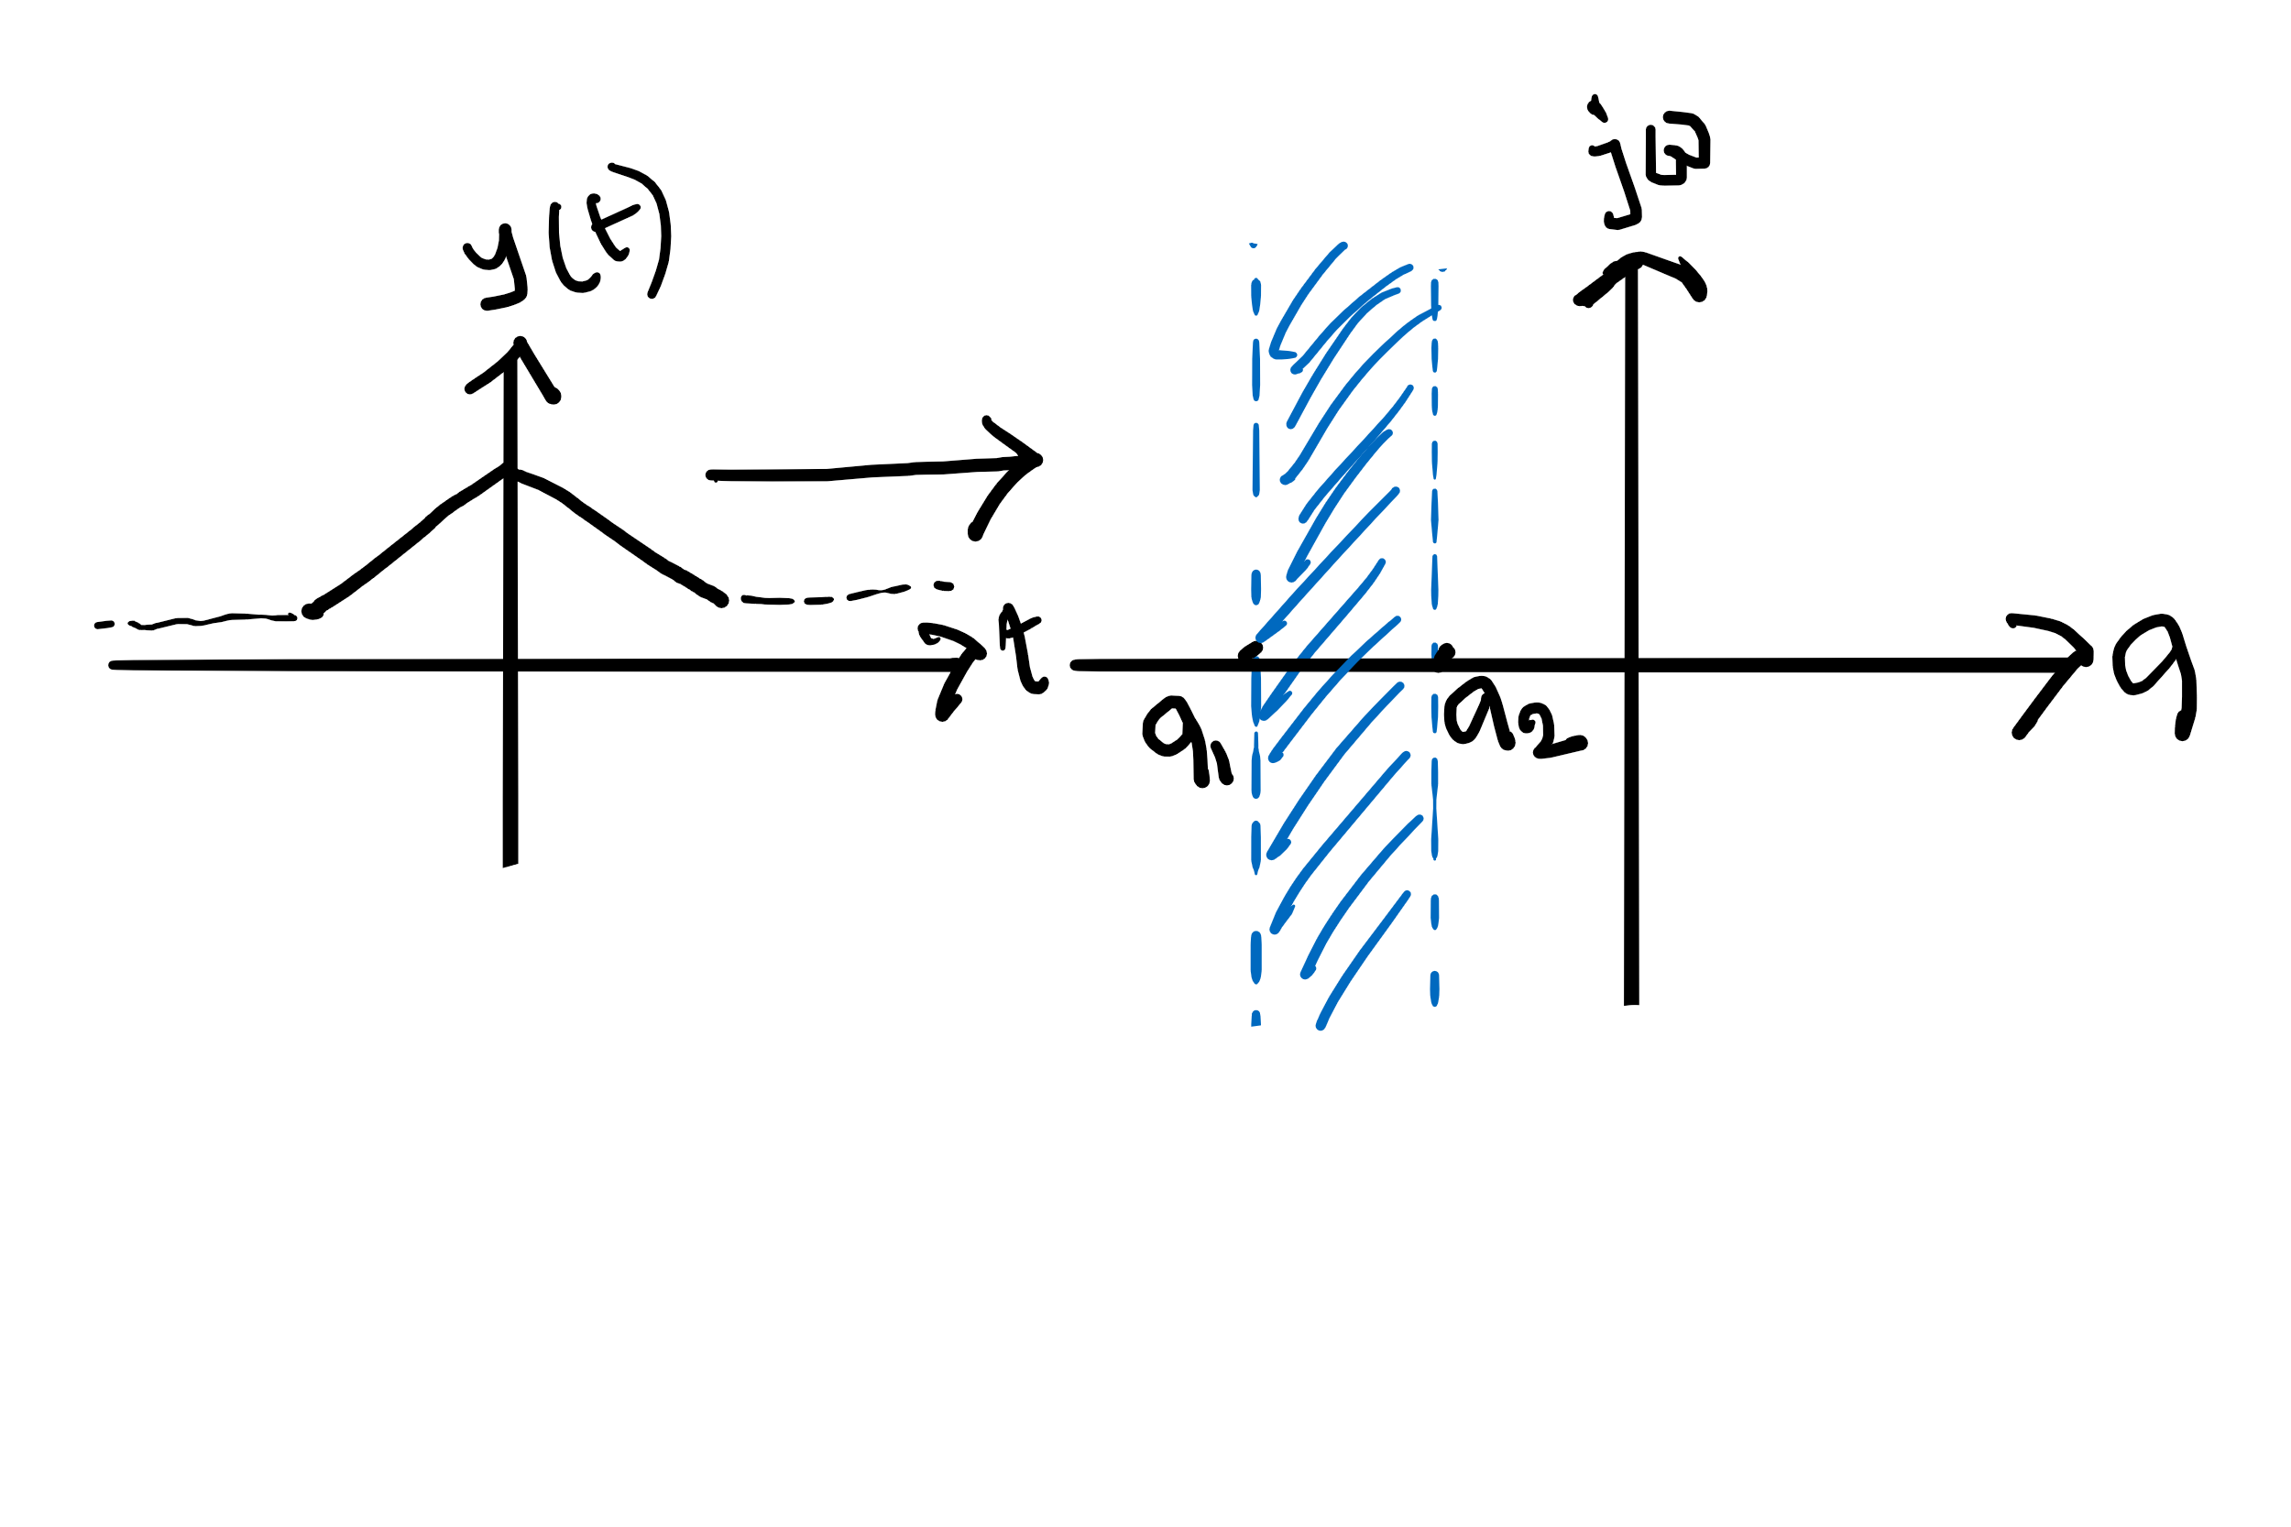
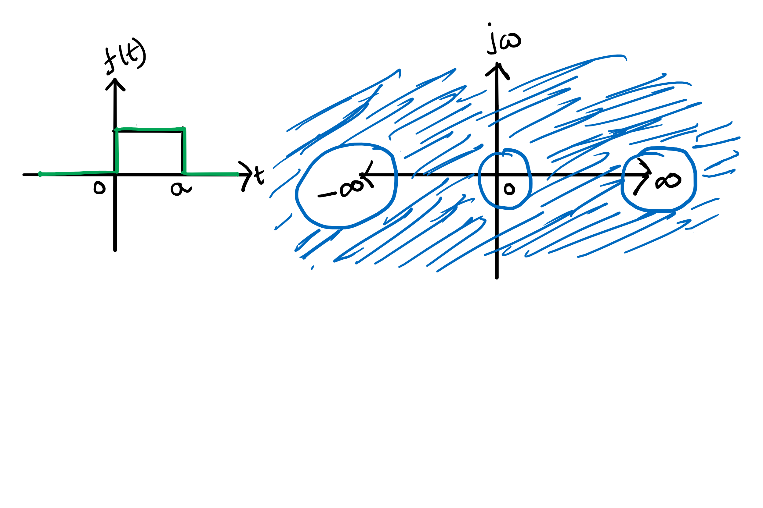
ROC & Its Properties
For the absolute integrability of a signal or the stability of a system, ROC should include imaginary axis.
For both sided signals, ROC is a strip in the s-plane.
For infinite duration signals, ROC is the entire s-plane, excluding s= 0, &/ s= ‒∞ &/ s= ∞

Slide 6
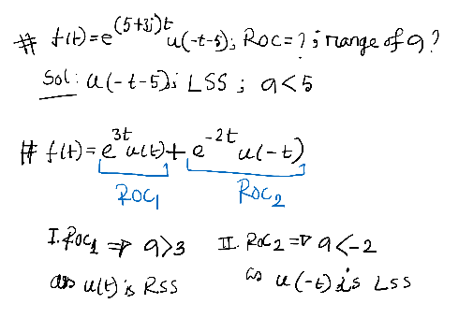
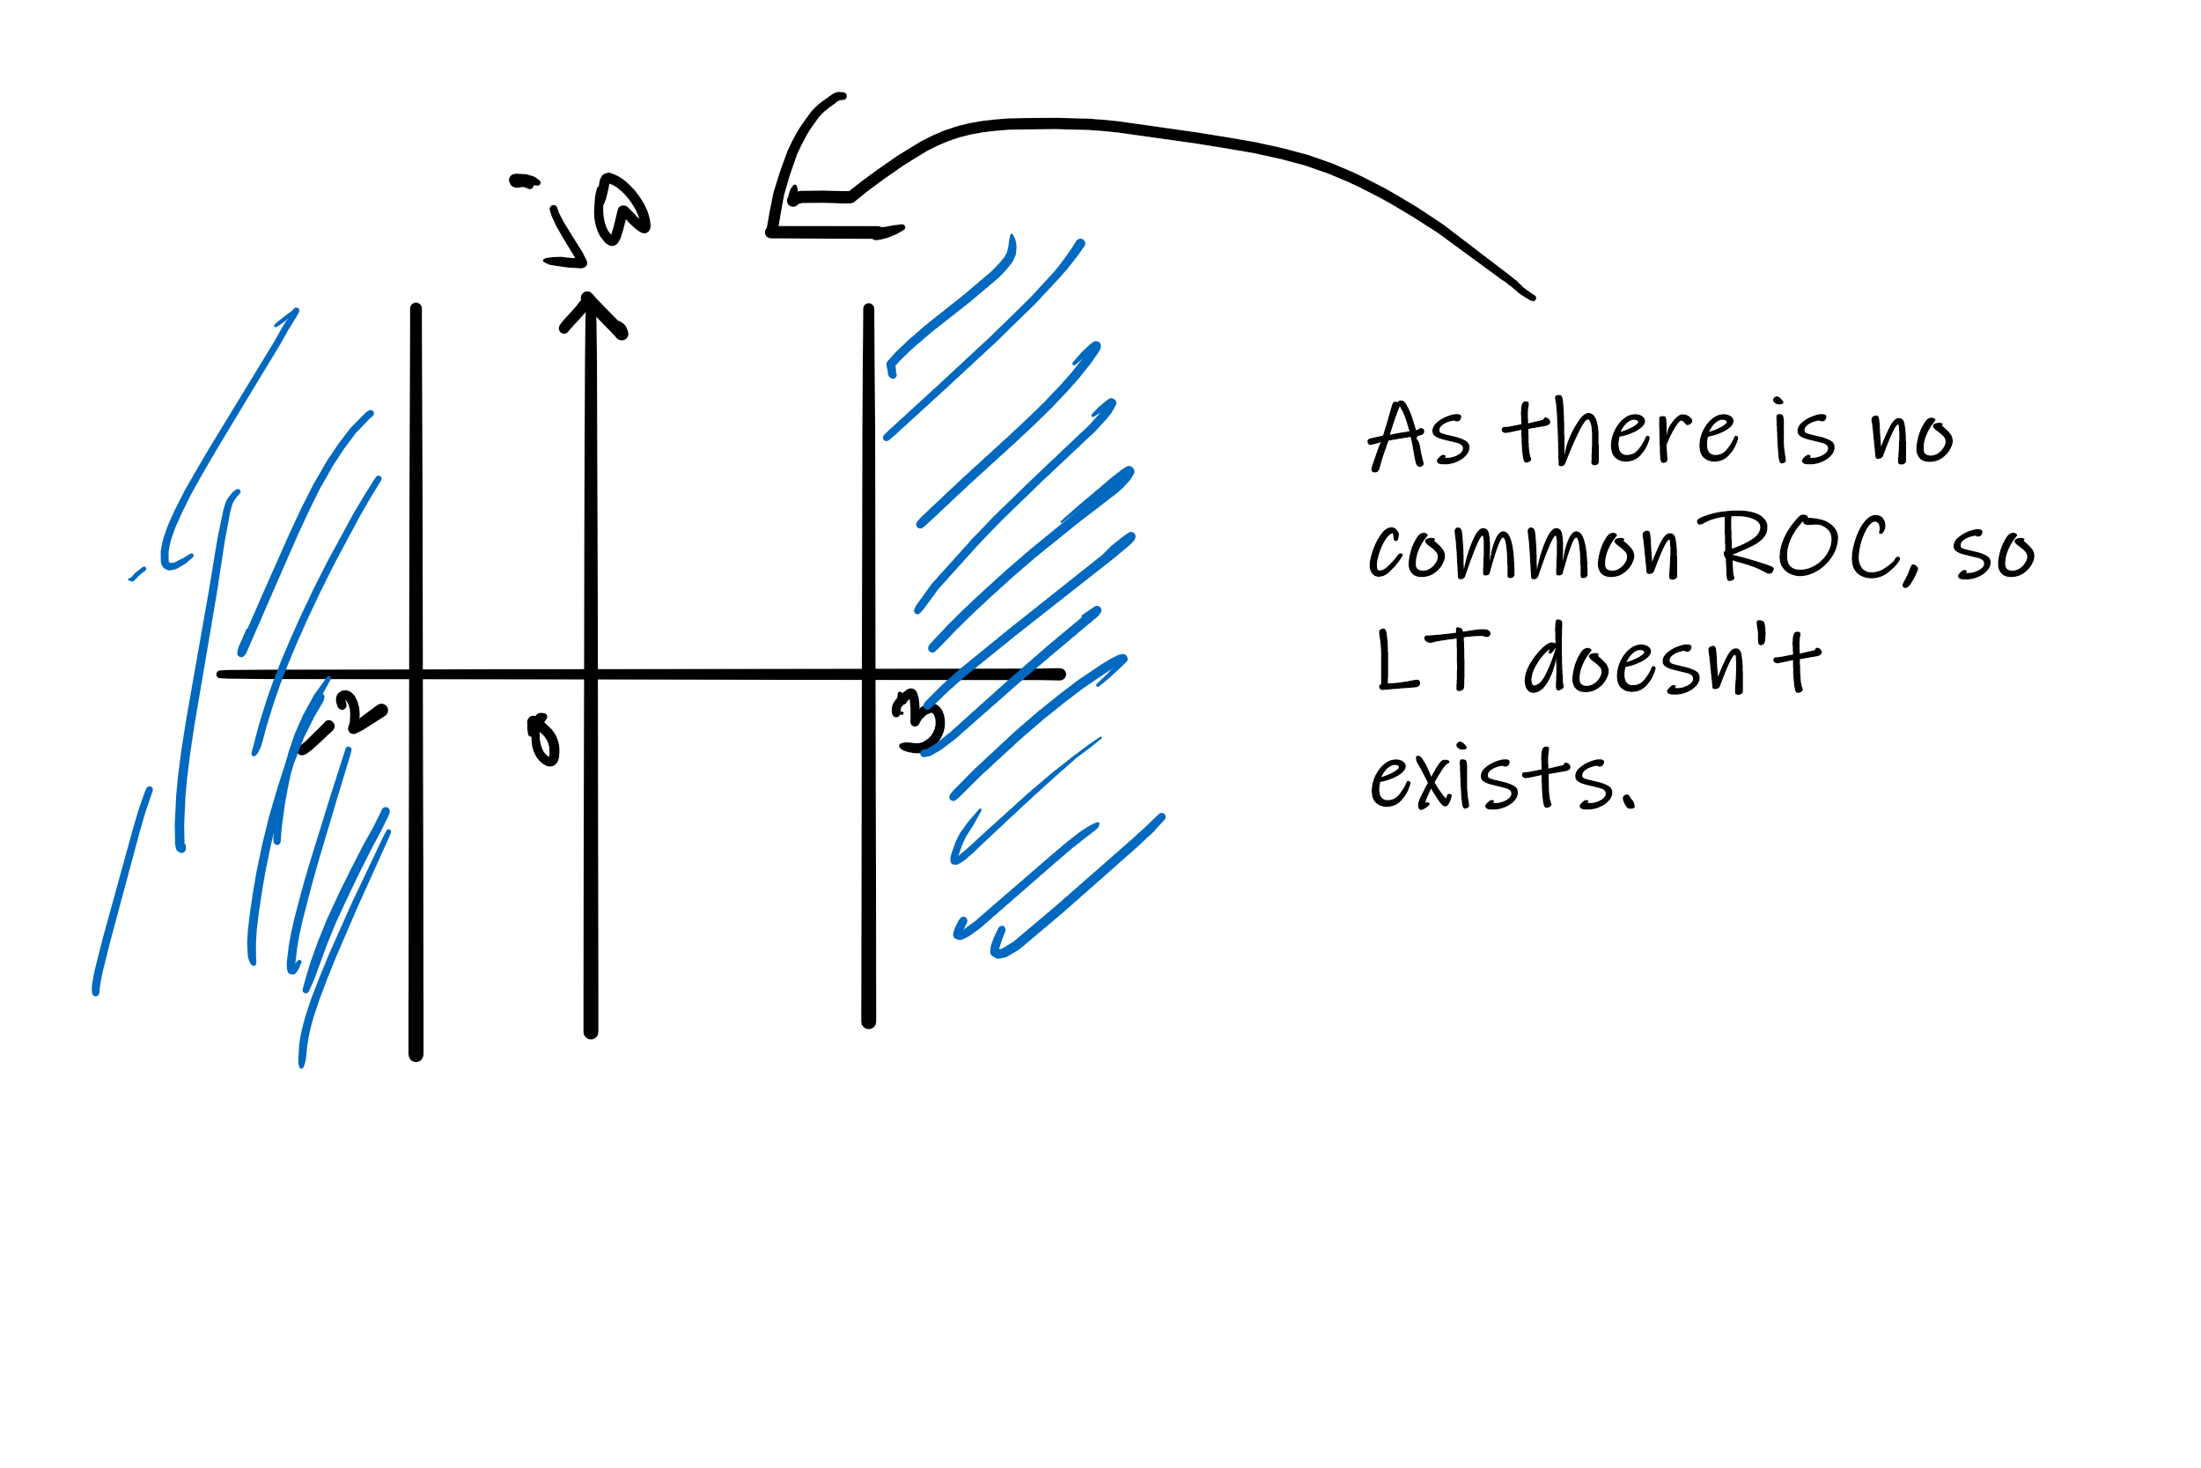
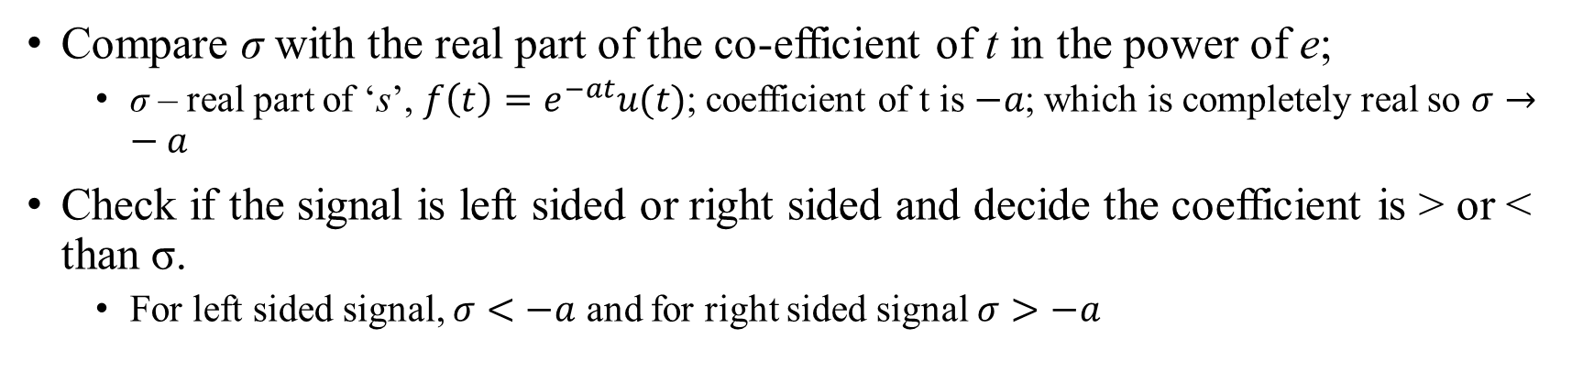
Calculating ROC
Compare σ with the real part of the co-efficient of t in the power of e;
σ – real part of ‘s’, $f\left(t\right)=e^{−at}u(t)$; coefficient of t is $−a$; which is completely real so $σ→−a$
Check if the signal is left sided or right sided and decide the coefficient is > or < than σ.
For left sided signal, $σ<−a$ and for right sided signal $σ>−a$

Slide 8
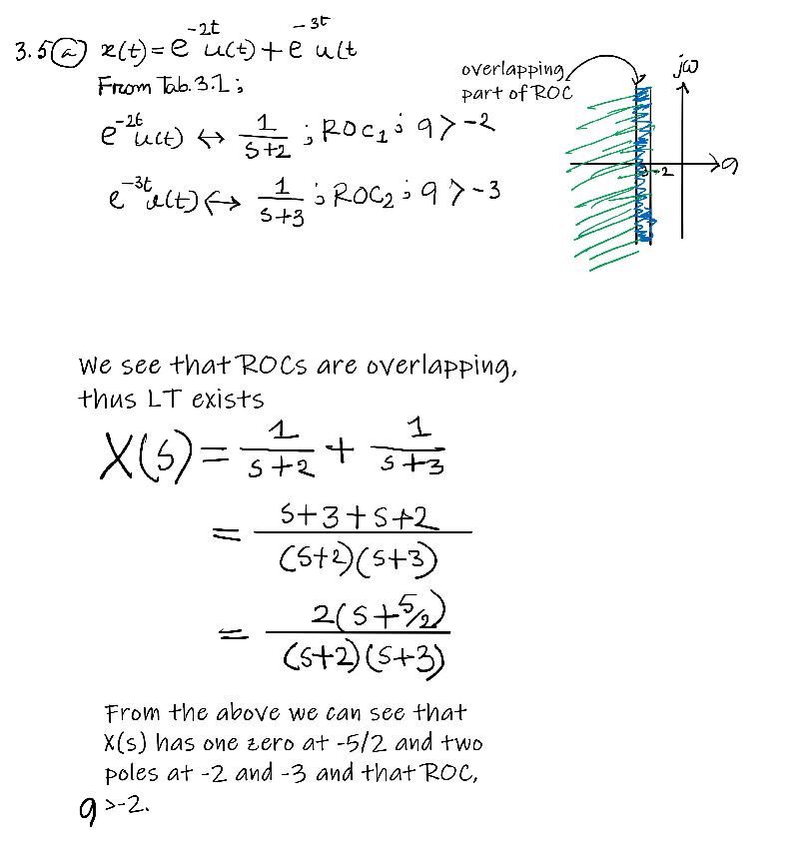
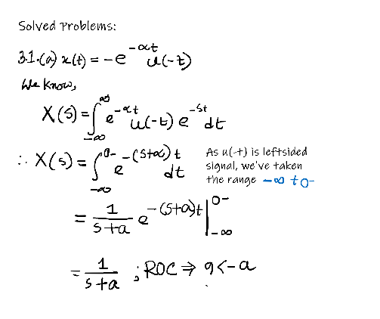
LT

Slide 9
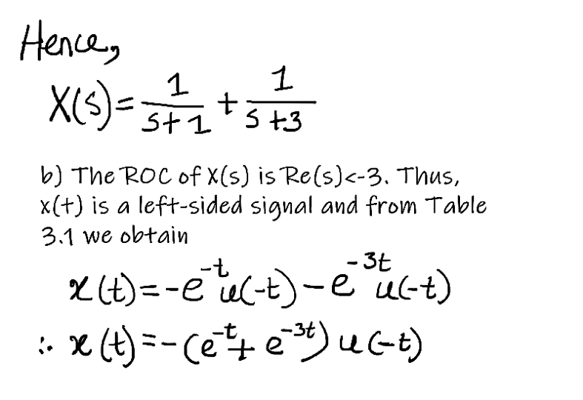
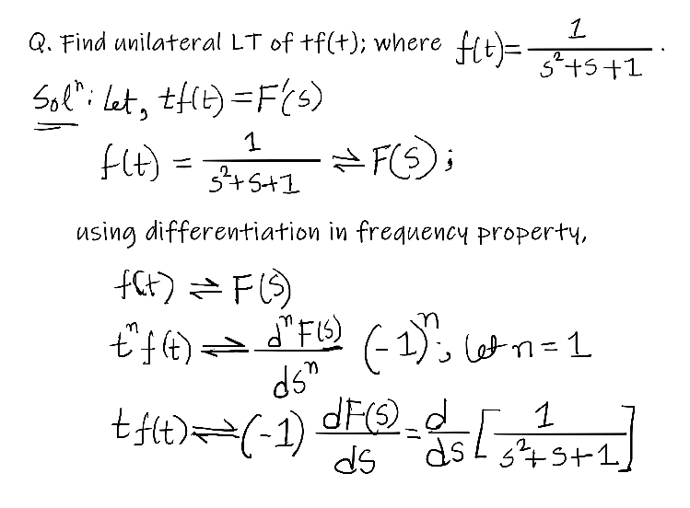
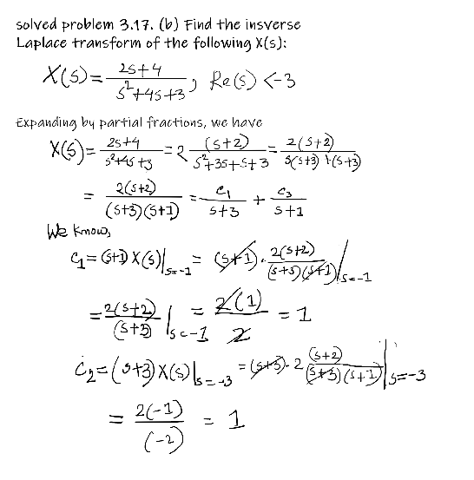
ILT

